Slide 1
Introduction to Classes
Department of Computer Science,
The University of Lahore

Slide 2
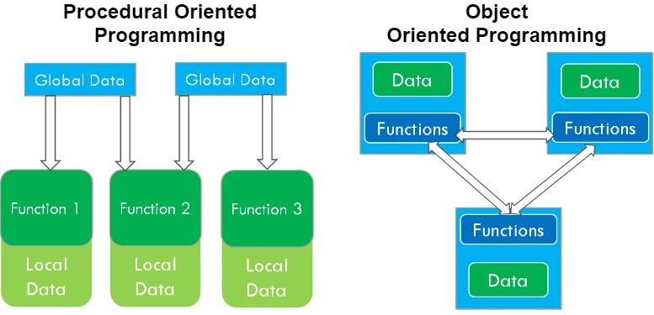
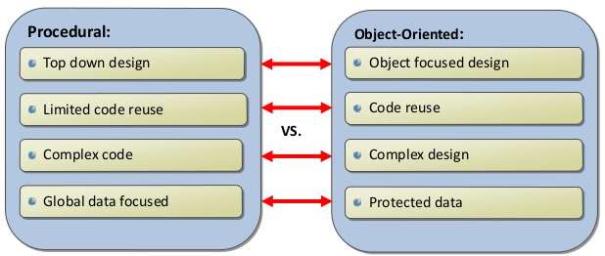
Procedural VS. Object-Oriented Programming

Slide 3
Object-oriented Programming (OOP)
Object-oriented programming approach organizes programs in a way that mirrors the real world, in which all objects are associated with both attributes and behaviors
Object-oriented programming involves thinking in terms of objects
An OOP program can be viewed as a collection of cooperating objects

Slide 4
Classes

Slide 5
Classes in OOP
Classes are constructs/templates that define objects of the same type.
A class uses Variables (data fields) to define state
A class uses Functions to define behaviors.
Additionally, a class provides a special type of function, known as constructors:
Invoked to construct objects from the class.

Slide 6
Objects in OOP
An object has a unique identity, state, and behaviors.
The state of an object consists of a set of data fields (also known as properties) with their current values.
The behavior of an object is defined by a set of functions.

Slide 7
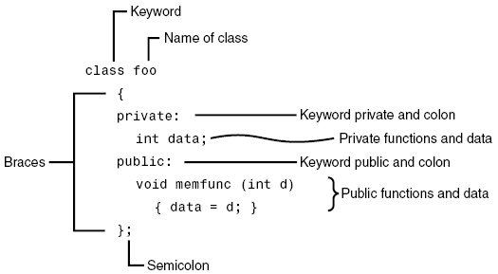
Class in C++ - Example

Slide 8
Class in C++ - Example
class
Circle
{
public
:
Note:
the special syntax for constructor
(no return type!)
// The radius of this circle
double
radius;
Data field
// Construct a circle object
Circle()
{
radius =
1
;
Constructors
}
// Construct a circle object
Circle(
double
newRadius)
{
radius = newRadius;
}
// Return th
e area of this circle
double
getArea()
Function
{
return
radius * radius *
3.14159
;
}
};

Slide 9
Class is a Type
You can use primitive data types to define variables.
You can also use class names to declare object names.
In this sense, a class is an abstract data-type or user-defined data type.

Slide 10
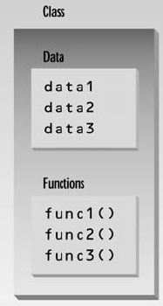
Class Data Members and Member Functions
The data items within a class are called data members or data fields or instance variables
Member functions are functions that are included within a class. Also known as instance functions.

Slide 11
Object Creation - Instantiation
In C++, you can assign a name when creating an object.
A constructor is invoked when an object is created.
The syntax to create an object using the no-arg constructor is:
ClassName objectName;
Defining objects in this way means creating them. This is also called instantiating them.

Slide 12
Object Member Access Operator
After object creation, its data and functions can be accessed (invoked) using:
The . operator, also known as the object member access operator.
objectName.dataField references a data field in the object
objectName.function( ) invokes a function on the object

Slide 13
A Simple Program – Object Creation
class Circle
{
private:
double radius;
public:
Circle()
{ radius = 5.0; }
double getArea( )
{ return radius * radius * 3.14159; }
};
C1
Object Instance
Allocate memory for radius
void main()
{
Circle C1;
//C1.radius = 10; can’t access private member outside the class
cout<<“Area of circle = “<<C1.getArea( );
}

Slide 14
Local Classes
Local classes: A local class is declared within a function definition.
Scope is within the function
Functions of local class must be inline
A local class cannot have static data members but can have static function.
Methods of local class can only access static members of the enclosing function.

Slide 15
Inline/Out-of-Line Member Functions
Inline functions:
are defined within the body of the class definition.
Out-of-line functions:
are declared within the body of the class definition and defined outside.

Slide 16
Inline/Out-of-Line Member Functions
If a member function is defined outside the class
Scope resolution operator (::) and class name are needed
Defining a function outside a class does not change it being public or private
Binary scope resolution operator (::)
Combines the class name with the member function name
Different classes can have member functions with the same name
returnType ClassName::MemberFunctionName( ){
…
}

Slide 17
Member Functions Separating Declaration from Implementation
class Circle
{
private:
double radius;
public:
Circle(double radius)
{ this->radius = radius; }
double getArea( ); // Not implemented yet
};
double Circle::getArea()
{ return this->radius * radius * 3.14159; }
Class must define a no-argument constructor too….
void main()
{
Circle C1(99.0);
cout<<“Area of circle = “<<C1.getArea();
}

Slide 18
1 // Fig. 6.3: fig06_03.cpp
2 // Time class.
3 #include <iostream>
4
5 using std::cout;
6 using std::endl;
7
8 // Time abstract data type (ADT) definition
9 class Time {
10 public:
11 Time(); // constructor
12 void setTime( int, int, int ); // set hour, minute, second
13 void printMilitary(); // print military time format
14 void printStandard(); // print standard time format
15 private:
16 int hour; // 0 – 23
17 int minute; // 0 – 59
18 int second; // 0 – 59
19 };
20
Note the :: preceding the function names.
21 // Time constructor initializes each data member to zero.
22 // Ensures all Time objects start in a consistent state.
23 Time::Time() { hour = minute = second = 0; }
24
25 // Set a new Time value using military time. Perform validity
26 // checks on the data values. Set invalid values to zero.
27 void Time::setTime( int h, int m, int s )
28 {
29 hour = ( h >= 0 && h < 24 ) ? h : 0;
30 minute = ( m >= 0 && m < 60 ) ? m : 0;
31 second = ( s >= 0 && s < 60 ) ? s : 0;
32 }

Slide 19
33
34 // Print Time in military format
35 void Time::printMilitary()
36 {
37 cout << ( hour < 10 ? "0" : "" ) << hour << ":"
38 << ( minute < 10 ? "0" : "" ) << minute;
39 }
40
41 // Print Time in standard format
42 void Time::printStandard()
43 {
44 cout << ( ( hour == 0 || hour == 12 ) ? 12 : hour % 12 )
45 << ":" << ( minute < 10 ? "0" : "" ) << minute
46 << ":" << ( second < 10 ? "0" : "" ) << second
47 << ( hour < 12 ? " AM" : " PM" );
48 }
49

Slide 20
Private Member Functions
Private Member Functions:
Only accessible (callable) from member functions of the class
No direct access possible (with object instance of the class)
Can be: inline / out-of-line

Slide 21
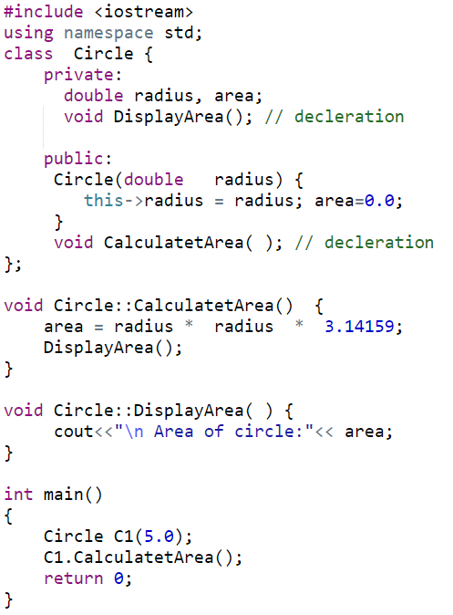
Private Member Functions (out-of-line)
Notes:
this->radius = radius;:
- The this->radius refers to the class's member variable radius.
- The radius without this refers to the parameter passed into the constructor.
- By using this->, we differentiate between the class's radius and the constructor's parameter radius.
So, in this line:
- this->radius: refers to the member variable radius of the current object.
- radius: is the parameter passed to the constructor.
- This makes sure that the value passed to the constructor is assigned to the object's own radius member variable.
Why this is important here:
Without the this keyword, the compiler would be confused because the parameter name radius is the same as the member variable name radius. Using this-> makes it clear that you are referring to the member variable and not the constructor parameter.

Slide 22
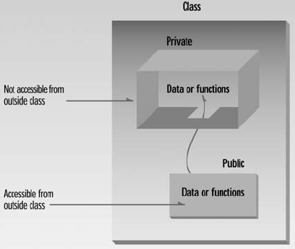
Access Modifiers/Specifier
Access modifiers are used to set access levels for variables, methods, and constructors
private, public, and protected
In C++, default accessibility is private
Notes:
A constructor can be public or private.
If there are multiple constructors of a class, then the constructor being used to construct an object must be public. Although, the constructors not being used to construct objects may still be “Private”

Slide 23
Member Access Specifiers
The default constructor (provided by compiler) is always public.
Programmer can specify a constructor to be private (no use) or public
public
Presents clients with a view of the services the class provides (i.e., interface)
Data and member functions are accessible (outside class)
private
Default access mode
Data only accessible to member functions and friends
private members only accessible through the public class interface using public member functions

Slide 24
Data Hiding - Data Field Encapsulation
A key feature of OOP is data hiding
data is concealed within a class so that it cannot be accessed mistakenly by functions outside the class.
To prevent direct modification of class attributes (outside the class), the primary mechanism for hiding data is to put it in a class and make it private using private keyword. This is also known as data field encapsulation.

Slide 25
Hidden from Whom?
Data hiding means hiding data from parts of the program that don’t need to access it. More specifically, one class’s data is hidden from other classes.
Data hiding is designed to protect well-intentioned programmers from mistakes.

Slide 26
A Simple Program – Accessing Member Function
class Circle
{
private:
double radius;
public:
Circle()
{ radius = 5.0; }
double getArea()
{ return radius * radius * 3.14159; }
};
C1
Object Instance
Allocate memory for radius
void main()
{
Circle C1;
//C1.radius = 10; can’t access private member outside the class
cout<<“Area of circle = “<<C1.getArea();
}

Slide 27
A Simple Program – Default Constructor
class Circle
{
private:
double radius;
public:
double getArea()
{ return radius * radius * 3.14159; }
};
C1
Object Instance
//Default Constructor
Circle()
{ }
// No Constructor Here
Allocate memory for radius
void main()
{
Circle C1;
//C1.radius = 10; can’t access private member outside the class
cout<<“Area of circle = “<<C1.getArea();
}

Slide 28
Object Construction with Arguments
The syntax to declare an object using a constructor with arguments is:
ClassName objectName(arguments);
For example, the following declaration creates an object named circle1 by invoking the Circle class’s constructor with a specified radius 5.5.
Circle circle1(5.5);

Slide 29
A Simple Program – Constructor with Arguments
class Circle
{
private:
double radius;
public:
Circle( ) {}
Circle(double rad)
{ radius = rad; }
double getArea()
{ return radius * radius * 3.14159; }
};
C1
Object Instance
Allocate memory for radius
void main()
{
Circle C1(9.0);
//C1.radius = 10; can’t access private member outside the class
cout<<“Area of circle = “<<C1.getArea();
}

Slide 30
Output of the following Program?
class Circle
{
private:
double radius;
public:
//Circle( ) { }
Circle(double rad)
{ radius = rad; }
double getArea()
{ return radius * radius * 3.14159; }
};
void main()
{
Circle C1;
cout<<“Area of circle = “<<C1.getArea();
}
Notes:
ERROR: No Argument is passed to constructor

Slide 31
const Member Functions
const Member Functions: Read-only functions cannot modify object’s data members

Slide 32
Constant Functions
class Circle
{
private:
double radius;
public:
Circle ()
{ radius = 1; }
Circle(double rad)
{ radius = rad; }
double getArea() const
{ return radius * radius * 3.14159; }
};
const member function cannot update/change object’s data
void main()
{
Circle C2(8.0);
Circle C1;
cout<<“Area of circle = “<<C1.getArea();
}

Slide 33
Accessors and Mutators(Getters & Setters)
Accessors: member function only reads/gets value from a class’s member variable but does not change it.
Mutators: member function that stores a value in member variable

Slide 34
const Objects
const Object: Read-only objects
Object data members can only be read, NO write/update of data member allowed
Requires all member functions be const (except constructors and destructors)
const object must be initialized (using constructors) at the time of object creation
Notes:
The const property of an object goes into effect after the constructor finishes executing and ends before the class's destructor executes. So the constructor and destructor can modify the object, but other methods of the class can't.
The reason for this is that the compiler cannot decide whether a method performs write operations or only read operations with data members unless additional information is supplied.

Slide 35
const Objects
const property of an object goes into effect after the constructor finishes executing and ends before the class's destructor executes
So the constructor and destructor can modify the object
Notes:
The const property of an object goes into effect after the constructor finishes executing and ends before the class's destructor executes. So the constructor and destructor can modify the object, but other methods of the class can't.
The reason for this is that the compiler cannot decide whether a method performs write operations or only read operations with data members unless additional information is supplied.

